Slide 1
Object Oriented Analysis and Design
Instructor:

Slide 2
Agenda
General Introduction
Object Modeling Technique (OMT)
Object-Oriented Analysis
Object-Oriented Design
Three models
Object Modeling
Dynamic Modeling
Functional Modeling
Four phases

Slide 3
General Introduction Object-Oriented Software Development
Object-Oriented Methodology
development approach used to build complex systems using the concepts of object, class, polymorphism, and inheritance with a view towards reusability
encourages software engineers to think of the problem in terms of the application domain early and apply a consistent approach throughout the entire life-cycle
Object-Oriented Analysis and Design
analysis models the “real-world” requirements, independent of the implementation environment
design applies object-oriented concepts to develop and communicate the architecture and details of how to meet requirements

Slide 4
General Introduction OMT & UML (OMT turned into UML)
OMT [Object Modeling Technique - Rumbaugh et al.,1991] consists of
building three complementary models of the system
adding implementation details to the models
implementing the models
OMT includes a set of
phases [processes]
diagramming techniques
OMT has four phases
object-oriented analysis builds a real-world model
system design determines overall architecture of system
object design decides upon data structures and algorithms
implementation translates design into programming language

Slide 5
General Introduction OMT Stages & Models
Analysis
- Model of real-world situation
- What ?
System Design
- Overall architecture (sub-systems)
Object Design
- Refinement of Design
- Algorithms/data structures to
implement each class
Implementation
- Translation of object classes and
relationships to a particular
object-oriented language
Object Model
- Static structure of objects and their relationships
(object diagram)
Dynamic Model
- Control aspects of the system
(state diagrams)
Functional Model
- Data value transforamtions
(dataflow diagrams)
time
System

Slide 6
General Introduction Object-Oriented Analysis
Builds a “real-world” model from requirements
client interviews, domain knowledge, real-world experience collected in use cases and other simple notations
OOA models address three aspects of the system (its objects)
class structure and relationships
sequencing of interactions and events
data transformations and computations

Slide 7
General Introduction Models of Object-Oriented Analysis
Class Model
static structure
what objects are in the system?
how are they related?
Dynamic Model
behavioral aspects
what events occur in the system
when do they occur and in what order?
Functional Model
data transformations
“what” does the system do
Data-Oriented
Action-Oriented
Both Data and Actions

Slide 8
General Introduction OO Analysis & Design Steps
Class Modeling
Dynamic Modeling
Functional Modeling
Add Operations to the Class Model
Iterate and refine the models
After the first iteration, steps may occur in parallel or out of order
All models must be kept in synch as changes are made

Slide 9
Class Modeling
Identify objects and classes
Prepare a data dictionary
Identify class attributes and initial set of operations
Identify associations between objects
Organize object classes using inheritance

Slide 10

Class Modeling What is an object?
Represent an entity in the “real” world
(Person)
Person
Joe Smith
age=39
weight=158
name
age
weight
(Person)
Mary Wilson
age=27
weight=121
Unique – Identifiable
Is a “black box” which receives messages
Notes:
Every object:
- Contains data: The data stores information that describes the state of the object.
- Has a set of defined behavior. This behavior consist of all the things that the object
"knows" how to do. These are the methods present inside the object.
- Has an individual identity. Each object is different from the other object even if they
are instantiated from the same class.
A primary rule of object-oriented programming is - as the user of an object, you would never need
to know what is there inside the object!

Slide 11
Class Modeling Abstraction
Polygon
Attributes:
- vertices
- border color
- fill color
Operations:
- draw
- erase
- move
Abstract info

Slide 12
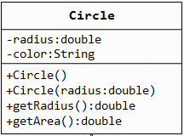
Class Modeling Classes, Attributes & Operations
Attributes define the properties of the objects
every instance of the class has the same attributes
an attribute has a data type
the values of the attributes may differ
among instances
Operations define the behavior of the
objects
action performed on or by an object
available for all instances of the class
need not be unique among classes
Class Attributes Operations
ball radius, weight catch, throw
football air pressure pass, kick, hand-off
baseball liveness hit, pitch, tag

Slide 13

Class Modeling Encapsulation
Allow to show only the important methods as interface
Hide detail information
Hide the data item
Hide the implementation
Access to data item only through member methods
Notes:
Capsule vs Tablet
Tablet : Thông tin/thành phần được exposed ra bên ngoài. Thuoc de bi tuong tac voi khong khi va nuoc. Khi uong co the co cam nhan ve mui vi cua thuoc
Capsule: Thành phần được gói kín bên trong. Thanh phan cua thuoc duoc bao ve tot hon. Khi uong, it kha nang cam nhan ve mui vi cua thuoc.
Encapsulation : Separate External Aspect from internal Implementation
Với encapsulation, OO can:
- hide the data item
- Chi co the access data item thông qua member method
Abstraction: Tell the external face we should present to the world
Encapsulation: Ensure implementation is not leak out
Abstraction & Encapsulation together reduce the amount of information we have to deal with.
Benefit:
Your brains doesn’t have to deal with it unless you’re specifically concerned with it
When change occurs, the effects are localized

Slide 14
Class Modeling Association and Links
An association is a relation among two or more classes describing a group of links, with common structure and semantics
A link is a relationship or connection between objects and is an instance of an association

Slide 15
Class Modeling Association and Links - Examples
Country
has-capital
City
Class diagram
name
name
(Country)
has-capital
(City)
Canada
Ottawa
(Country)
has-capital
(City)
Object diagram
France
Paris
(Country)
has-capital
(City)
Austria
Vienna

Slide 16
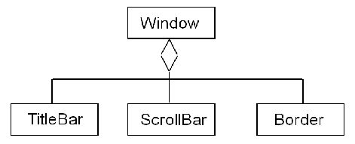
Class Modeling Aggregation
Aggregation is a special form of association that indicates a “part-of” relationship between a whole and its parts
Useful when the parts do not have independent existence
A part is subordinate to the whole

Slide 17
Class Modeling Inheritance
Classes with a set of similar attributes and operations may be organized into a hierarchical relationship
Common attributes and operations are factored out and assigned to a broad superclass (generalization)
generalization is the “is-a” relationship
superclasses are ancestors, subclasses are descendants
A class can be iteratively refined into subclasses that inherit the attributes and operations of the superclass (specialization)

Slide 18
Class Modeling Advantages of Inheritance
Development model closer to real life object model with hierarchical relationships
Reusability – reuse public methods of base class
Extensibility – Extend the base class
Data hiding – base class keeps some data private ➔ derive class cannot change it
Rapid prototyping
Notes:
All benefit apply to design, development and maintenance.
Do you see any disadvantages to inheritance?

Slide 19
Class Modeling Domain Analysis
Natural Language
Problem Domain
Nouns suggest candidate Classes.
Not every noun is an Object Class.
Some are attributes of another Class.
Some are irrelevant, outside the scope of the application.
Verb phrases suggest class associations
Some relationships are irrelevant (caution).
Proper nouns suggest Objects of a Class type. Beware of singular nouns.

Slide 20
Class Modeling Classes Identifying
Finding classes:
Use domain analysis as before.
Derive them from the use cases (descriptions).
Look for data which must be stored or analysed.
Are there external systems?
Are there any devices under the control of the system?
Are there any organisational parts?

Slide 21
Class Modeling - An Example
FastData Inc. wants a subsystem to process office supply orders via the Web. The user will supply via a form their name, password, account number, and a list of supplies along with an indication of the quantities desired. The subsystem will validate the input, enter the order into a database, and generate a receipt with the order number, expected ship date, and the total cost of the order. If the validation step fails, the subsystem will generate an error message describing the cause of the failure.
Notes:
We will demonstrate the UML /OMT using this example
Class modeling will be done first
This example does not demonstrate how the technique is applied to ALL problems. Be sure to distinguish between the details of the example and the details of the technique!
Cho sinh vien 5 phut doc vi du.

Slide 22
Class Modeling - Concise Problem Definition
Define the problem concisely
Use only a single sentence
“FastData, Inc. employees may order office supplies via the Web and receive a receipt confirming the order”
This is the first step towards identifying the classes of the subsystem

Slide 23
Class Modeling - Informal Strategy
Identify the constraints governing the system
Use only a single paragraph
“FastData, Inc. employees may order office supplies via the Internal Web and receive a receipt confirming the order. The order must include the user name, user password, account number, and the list of supplies. A receipt must be generated containing an order number, ship date, and total cost. If the order is valid, it must be entered into an order database. If the order is invalid, an error message must be generated.”
We now have more information to be used in identifying classes for the subsystem

Slide 24
Class Modeling - Formalize the Strategy
Identify the nouns of the description, which serve as the basis for identifying the subsystem’s classes.
Look for out-of-domain nouns (and throw them out!)
Look for abstract nouns (use these for attributes)
The remaining nouns are good candidates!
“FastData, Inc. employees may order office supplies via the Internal Web and receive a receipt confirming the order. The order must include the user name, user password, account number, and the list of supplies. A receipt must be generated containing an order number, ship date, and total cost. If the order is valid, it must be entered into an order database. If the order is invalid, an error message must be generated.”

Slide 25
Nouns
Out-of-Domain
Internal Web
Abstract
user name
user password
account number
order number
ship date
total cost
list of supplies
office supplies -> item
Good Candidates
employee
item (was office supplies)
receipt
order
order database
error message
Notes
We have decided not to worry about the Web in this design. Instead we focus on the inputs and outputs and defer the Web details until later.

Slide 26
Class Model
employee
order
order DB
name
password
number
account
total cost
error message
receipt
item
explanation
order number
ship date
total cost
name
quantity
price

Slide 27
Class Model, continued
Since both receipts and error messages will be generated as output
it might make sense to have them as subclasses of a more general
class. We do not know enough yet to assign it attributes however.
response
error message
receipt
explanation
order number
ship date
total cost

Slide 28
Class Modeling - Relationships
employee
order
order DB
name
password
number
account
total cost
1+
error message
receipt
item
explanation
order number
ship date
total cost
name
quantity
price

Slide 29
Dynamic Modeling
Prepare scenarios
Identify events between objects
Prepare an event trace for each scenario
Build a state diagram
Match events between objects to verify consistency

Slide 30
Dynamic Modeling An example scenario
Scenario for a phone call
caller lifts receiver
dial tone begins
caller dials digit (2)
caller dials digit (7)
caller dials digit (7)
caller dials digit (6)
specified phone rings
etc.

Slide 31
Dynamic Modeling OMT Event Trace Notation
objects are vertical lines
events are horizontal lines
arrows indicate sender and receiver
time passes from top to bottom
Caller
Phone line
Callee
caller lifts receiver
dial tone begins
dials (2)
dial tone ends
dials (7)
dials (7)
dials (6)
ringing tone
phone rings
answers phone
phones connected
phones connected
callee hangs up
connection broken
connection broken
caller hangs up

Slide 32
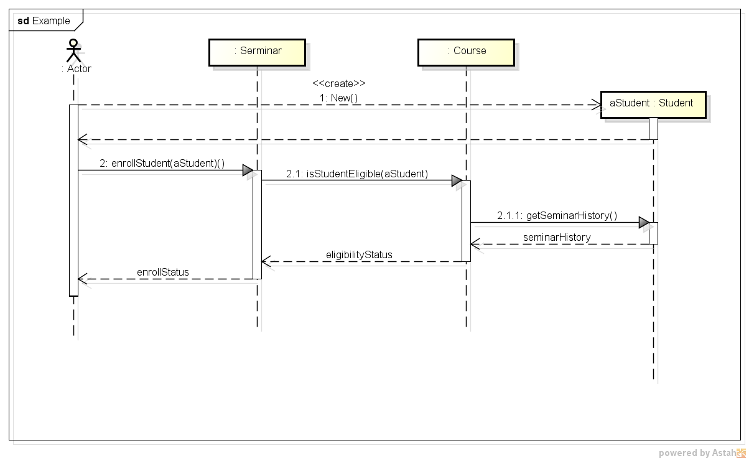
Dynamic Modeling Event Trace ~ Sequence Diagram
Actor
Object: Class
Message
Reply Message
Lifeline

Slide 33
Functional Modeling Hierarchical DFD
High-level functionality iteratively refined into smaller functional units
each high-level process may be expanded into a separate DFD
top-level processes correspond to operations on complex objects, while lower-level processes are operations on basic objects
Nesting depth is dependent on application
terminates with simple functions
each level must be coherent
Hierarchical DFD corresponds to the following
context diagram shows boundaries of system
mid-level DFDs show context decomposition
primitive DFDs are simple functions that need not be expanded

Slide 34
Functional Modeling DFD Example: Office Supply
Employee DB
AccountDB
verification
name/
password
account
number
verification
Web Server
input
stream
validate
employee
employee
validate
order
order
response (receipt)
Product DB
Order DB
verification
item
order
info
order
order
process
order
validated
order
finalize
order
response (receipt)

Slide 35
Add Operations to the Object Model
From the Object Model:
Reading/writing object attributes (e.g., get_width, get_height of Rectangle)
From Events, State Actions, and Activities in the Dynamic Model:
Each event sent to an object => operation (e.g., Vending machine: set_balance)
Actions/activities may be operations (e.g., Vending machine: do: test item and compute change)
From Functions in the Functional Model:
Each function in the DFD corresponds to an operation (e.g., bank example: subtract withdrawal from Account)

Slide 36
OMT: Four Phases
System design
determines overall architecture of system
Object design
Definition all the classes in the system
Detailed Design
decides upon data structures and algorithms
Implementation
translates design into programming language

Slide 37
OMT: Four phases 1. System Design
Devises high-level strategy for solving problem
Set trade-off priorities
Construct system architecture by organizing into subsystems (system structuring)
Choose an approach for persistent data management (repository model)
Allocate components to processors and tasks (distribution model)
Choose the implementation of control in software system (control modeling)
Identify concurrency inherent in the problem
Define access to global resources
Divide problem into implementable components (modular decomposition)

Slide 38
OMT: Four phases 2. Object Design
Full definition of all the classes in the system
Implementation alternatives evaluated and chosen
Combine three models to obtain class operations
Design algorithms to implement operations
Optimize access paths to data
Implement control for external interactions
Adjust class structure to increase inheritance
Design associations and setermine object representation
Package classes and associations into implementable modules

Slide 39
OMT: Four phases 3. Detailed Design 1/2
Detailed design is the process of completely specifying an architectural design such that module implementation can proceed (independently)
Interface specifications
brief description of each module
attributes
brief description and specify types
operations
brief description
list of parameters and parameter types
return type (if applicable)

Slide 40
OMT: Four phases 3. Detailed Design 2/2
Algorithm and data structure specification
the designer can give hints as to what algorithms or data structures might be most useful for a particular module
also, the client may have specified a particular algorithm or data structure that must be used
in addition, constraints in the requirements may require one approach over another
for instance, implementing a data structure so that it uses the minimum amount of memory possible vs. keeping everything in memory for speed

Slide 41
OMT: Four phases 4. Implementation 1/2
Most programming languages provide very similar sets of features
user-defined types
control structures
if...then...else...
while x do y
for i = 1 to x
etc
etc.
This means that, in general, operations can be expressed in many different languages

Slide 42
OMT: Four phases 4. Implementation 2/2
Major differences between languages usually fall into these categories
compiled vs. interpreted
procedural vs. object-oriented
general purpose vs. application/domain specific
e.g. C++ vs. FileMaker Pro’s scripting language
If a design takes advantage of, or depends on, one or more of these features then certain programming languages have to be excluded from implementation

Slide 43


